Slide 1
Session 4.1: Planning and Mitigation
Disinformation/Malign Influence Training
SJ Terp & P Breuer, Threet Consulting | 2021

Slide 2
Planning and mitigation
Practical: planning and mitigation
Lifecycle based planning
Killchain based planning

Slide 3
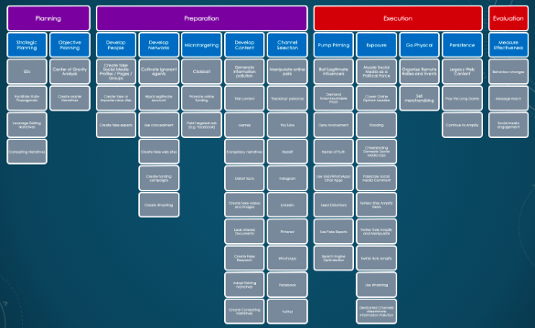
Operationalizing AMITT

Slide 4
Lifecycle based planning

Slide 5
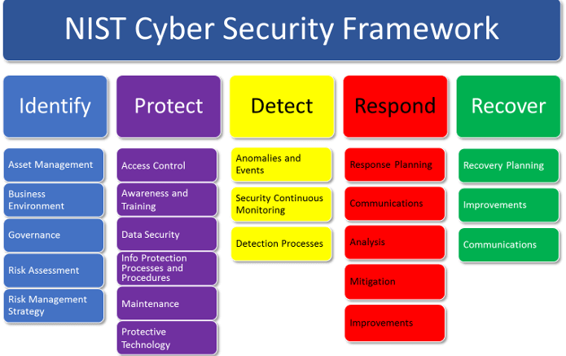
NIST framework

Slide 6
CS-ISAO SERVICE OFFERING
Identification | Understanding Cognitive Security to identify and manage risks (people, assets, data, technology, capabilities, policies/ laws/regulations, vulnerabilities, supply chain) and identification of the adversarial domain
Protection | Implementing safeguards to ensure integrity and availability of information systems and assets – Ability to limit or contain impacts – Provide awareness and education
Detection | Monitoring, detecting and sharing Cognitive Security intelligence, trends, threats, attacks and their impacts
Response | Communication of countermeasures (executing response processes, analysis, mitigation, benefitting from lessons learned
Recovery | Maintaining resilience plans, restoring impacted information, systems and assets, benefitting from lessons learned

Slide 7
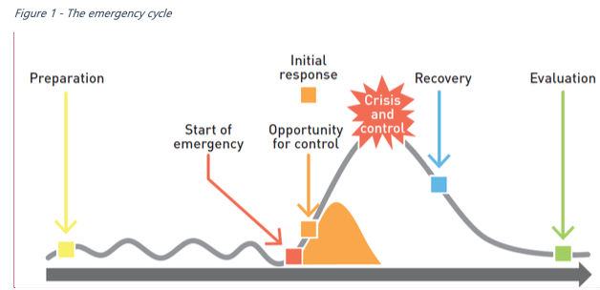
Emergency Lifecycle Models

Slide 8
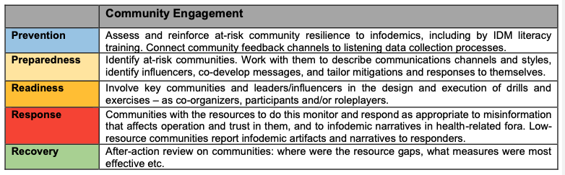
WHO Europe: Full-lifecycle risk management
Large UN agency
Techniques a mix of crisis response and infosec
Aimed at regions and countries

Slide 9
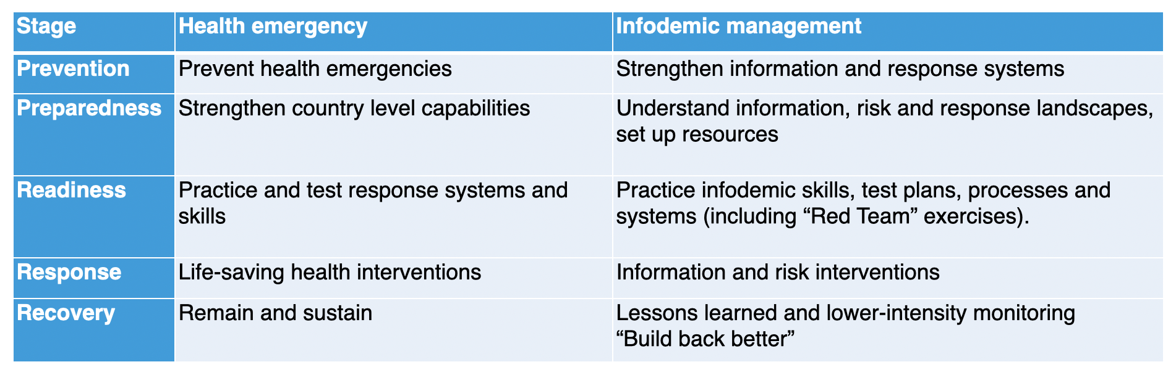
WHO crisis stages

Slide 10
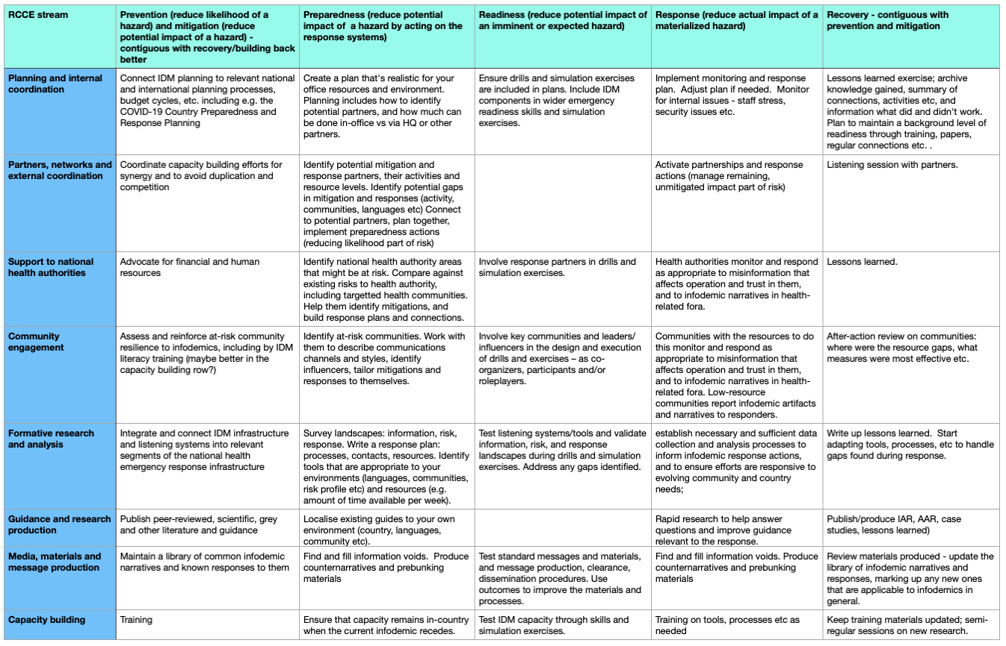

Slide 11
EXERCISE: What are your crisis stages?

Slide 12
Kill Chain based planning

Slide 13
Formal Planning and Operational
Planning
Preparation
Execution
Evaluation
Purposes of planning
A failure to formally plan results in completely reactive response
Identify shortfalls and opportunities
Prepare and coordinate detection, tripwires, authorities, and capabilities
Identify and prepare measures of effectiveness
Murphy gets a vote (but conversations have been front-loaded)
Formal planning is a master’s level degree (drink from the firehose)

Slide 14
Kill Chain
Strategic Planning
Objective Planning
Planning
Develop People
Develop Network
Micro- targeting
Develop Content
Channel Selection
Preparation
Pump Priming
Exposure
Go Physical
Persistence
Execution
Kill Chain
Represents the minimum number of tasks required for attack
A broken link results in failed attack
Action requires: intel, access, capability, and authority
Measure Effectiveness
Evaluation

Slide 15
Kill Chain: Planning
Planning
Strategic Planning
Objective Planning
Planning Phase
Strategic Planning
Define the desired end-state
Identify the center of gravity
Identify points of influence
Object Planning
Must directly support strategic objectives
Must be realistic, achievable, and measurable
Must answer the “5 Ws”

Slide 16
Kill Chain: Preparation
Preparation
Develop People
Develop Network
Microtargeting
Develop Content
Channel Selection
Preparation Phase
Develop People
Develop online and offline users, agents, and bots
Develop Network
Develop online and offline communities and transmission methods
Cultivate assets and “useful idiots”
Microtargeting
Define, understand, and develop specific subgroups
Identify influence points for specific subgroups
Develop Content
Create and acquire content to deliver to microtargeted groups
Channel Selection
Set-up deliver, amplification, and manipulation channels for attack
Each channel serves as an atomic surface (test bed)

Slide 17
Kill Chain: Execution
Execution
Pump Priming
Exposure
Go Physical
Persistence
Execution Phase
Pump Priming
Release content on a small scale including release and seed narratives
A-B testing and message honing
Exposure
Release content to general public or larger population
Go Physical
Move incident to offline to attract larger audience (protests, talks, signs, t-shirts, etc.)
Persistence
Keep incident “alive” beyond initial release
Amplify existing narratives
Conduct “sequel” operations

Slide 18
Kill Chain: Evaluation
Evaluation
Measure Effectiveness
Evaluation Phase
Measure effectiveness of incident for use in future actions
Both an art and a science
Three types of measures
Measures of Performance (MOP): How much was done
Measures of Effectiveness (MOE): How well was the objective accomplished
Measures of Effectiveness Indicators (MOE(I)): Quantitative measure that lend insight into a measure of effectiveness
Evaluation feeds into decision for a branch or sequel

Slide 19
Mitigation

Slide 20
Definition
Mitigation: the process or result of making something less severe, dangerous, painful, harsh, or damaging (Merriam-Webster Dictionary, 2021)

Slide 21
Kill Chain
Strategic Planning
Objective Planning
Planning
Develop People
Develop Network
Micro- targeting
Develop Content
Channel Selection
Preparation
Pump Priming
Exposure
Go Physical
Persistence
Execution
Kill Chain
Represents the minimum number of tasks required for attack
A broken link results in failed attack
Action requires: intel, access, capability, and authority
Evaluation
Measure Effectiveness

Slide 22

Defense: AMITT Planning Phase
Two sets of tasks
Strategic Planning
We known our own COGs
We know what we need to protect
Objective Planning
We know what’s critical
We know what’s anomalous
AI/Automation is plausible for early warning

Slide 23
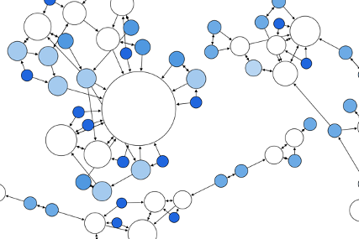
Defense: AMITT Preparation Phase
Network Development
Identify influencers
Identify “at risk” populations
Microtargeting
Social media tools are custom-made for this
Identification of misinformation targets
Proactive message, removing information deserts
Content development
AI is great for A-B testing and message honing
Channel Selection
“At risk” populations dictate channels
Channel infiltration may take time

Slide 24

Defense: AMITT Execution Phase
Pump Priming
Difficult to influence adversaries’ pump priming but not impossible
Pump prime friendly and “at risk”
Exposure
Countering messages
Basic fact-checking
Data provenance
Deep fake detection (automated)
Current deep fakes are perceptively bad
Mathematical anomalies
Medical anomalies
Countering after infection must overcome cognitive friction and cognitive dissonance
Go Physical
Overt presence
Merchandising (possible EO 12333 concerns)

Slide 25

Defense: AMITT Evaluation Phase
Persistence
Do NOT use bots
Measure effectiveness
A-B testing for counter narratives
Rapid evaluation of big data for analysis by using social media tools
Wash, rinse, repeat

Slide 26
Session 4.2: Context analysis
Disinformation/Malign Influence Training
SJ Terp & P Breuer, Threet Consulting | 2021

Slide 27
Context analysis
Social network analysis
Mapping and measuring relationships and information flows between people, groups, URLs, and other information entities.
Techniques and tools for assessing the relationships between disinformation artifacts, narratives, and other incident objects.

Slide 28
Social network analysis

Slide 29
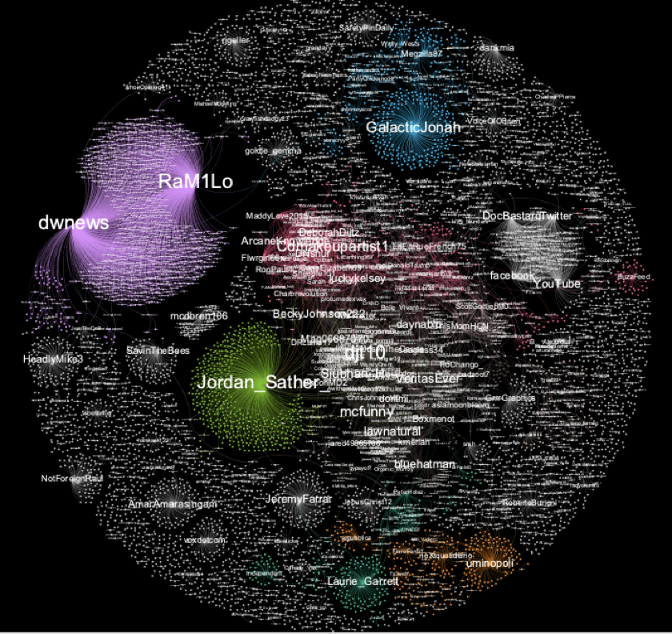
Activities
Understand structure & relationships
Get data
Find relationships in data
Convert to graph
Find structures in graph
Interpret structures
Bonus: monitor results of actions
Take action
Analyse structures
Adapt actions

Slide 30
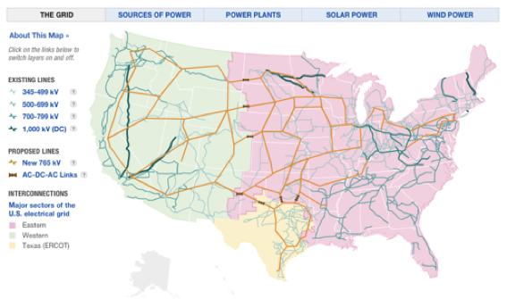
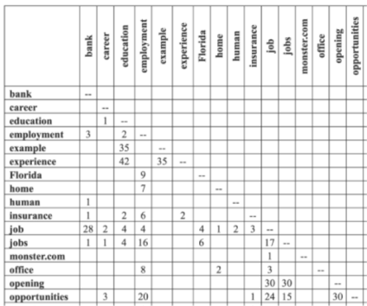
Relationships
Social media accounts
Hashtags
URLs
Images
Text
Documents
Groups
...

Slide 31
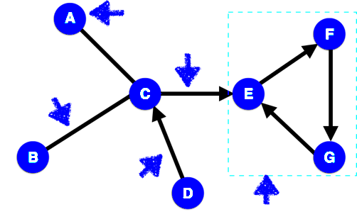
Relationships as Networks
Node
Edge
Undirected edge
Directed edge
Clique
Notes:
We’re going to be dealing with simple networks. These each have features, that we need to be able to name.
Node: object in the network (e.g. two people)
Edge: link between two objects (e.g. a friendship)
Directed edge: link for a relationship that just goes one way (e.g. a ‘friends’ b, but b doesn’t ‘friend’ a).
Clique: set of nodes where every node in the clique is connected every other node in the clique.

Slide 32
Network Tools
Standalone analysis tools:
Gephi
NodeXL
Cytoscape
(NetMiner)
Standalone visualisation tools:
D3.js
Python analysis libraries:
NetworkX
Python visualisation tools:
Matplotlib
Notes:
Longer list: http://en.wikipedia.org/wiki/Social_network_analysis_software

Slide 33
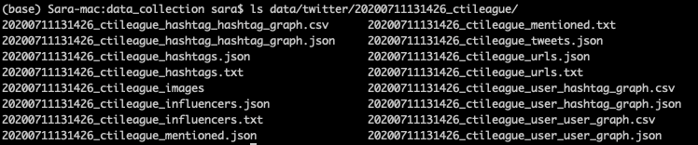
Gephi: get dataset
Get data collection code: https://github.com/cogsec-collaborative/amitt_tracking/blob/master/andypatel_get_data.py
In terminal window, type: “python andypatel_get_data.py ctileague”
This creates a directory with files:
User-user: counts replies, retweets, quotes, mentions
Hashtag-hashtag: counts co-occurrences
User-hashtag: counts hashtag use

Slide 34
Gephi: create graph
Get tool: https://gephi.org/users/download/
Build graph:
Start Gephi. Click on top menu>file>“import spreadsheet”. Grab User_user_graph.csv - use all defaults
Top menu: Go to data laboratory, “copy data to another column”, click ‘id’, click okay.
Go to overview. RHS: Run modularity algorithm, using defaults
RHS: Run average weighted degree algorithm
LHS: Click color icon, then partition, modularity class. Open palette, generate, unclick “limit number of colors”, preset=intense, generate, okay
LHS: Select “tt”, ranking, weighted degree, set minsize=0.2, choose 3rd spline, apply
LHS: Layout: OpenOrd, run. Then forceatlas2, run. Try stronger gravity, and scaling=200
Top menu: Preview - select “black background”, click “refresh”. Click “Reset zoom”

Slide 35
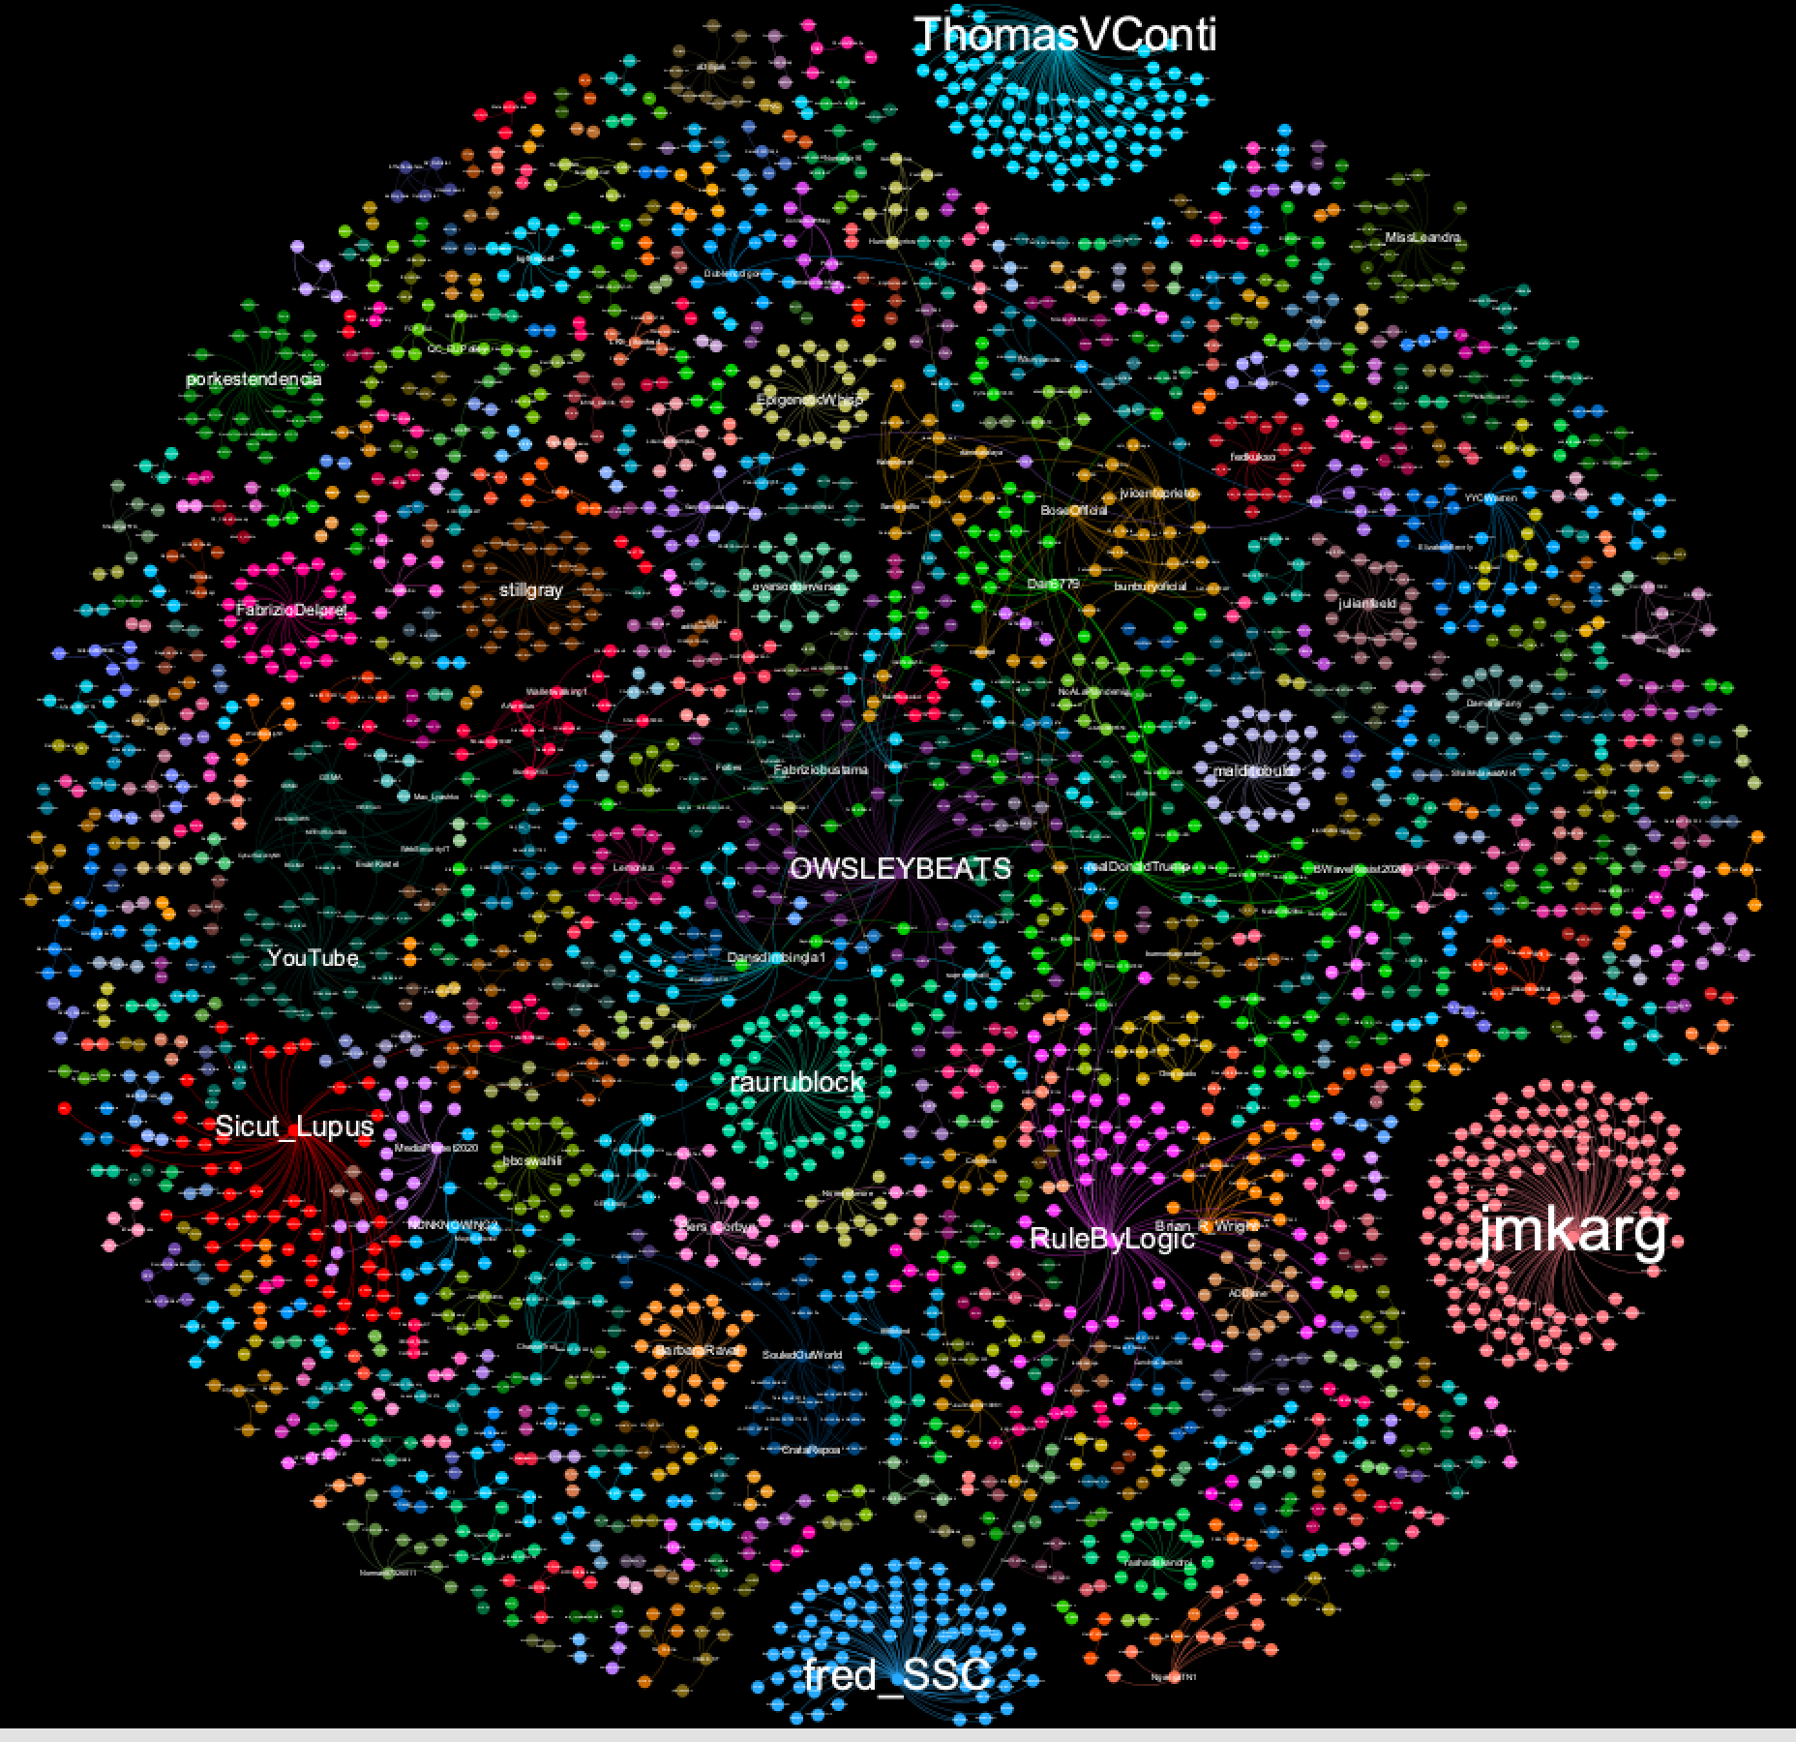
Covid5G
Notes:
Graph: Covid5G

Slide 36
Network analysis
Analysis tools
Gephi does this. In Python, NetworkX is simple to use
Analysis questions
Centrality: how important is each node to the network?
Community detection: what type of groups are there in this network?
Transmission: how might (information, disease, etc) move across this network?
Network characteristics: what type of network do we have here?
Network properties:
Characteristic path length: average shortest distance between all pairs of nodes
Clustering coefficient: how likely a network is to contain highly-connected groups
Degree distribution: histogram of node degrees
Disconnection
(scale-free networks)
And also
Overlapping community detection (modularity etc)
Homophily (how node dissimilarity affects networks)
Graph cohesion (which nodes strengthen or weaken a network)
Graph skeletons (e.g. minimum spanning trees)
Marketing metrics (reach etc)

Slide 37
Centralities
Degree centrality: who has lots of friends
Betweenness centrality: who are the bridges
Closeness centrality: who are the hubs
Eigenvalue centrality: who has most influence
Notes:
Eigenvector centrality measures how much influence a node has in the whole network, taking account of their connections to other highly-connected nodes. These are the “kings” of your network - they might not have great closeness or betweenness, but they do wield a lot of influence. The algorithm behind Google search, PageRank, is based on eigenvector centrality.
NB Eigenvector centrality algorithms are complex, and won’t always give you a solution.

Slide 38
Communities
Communities = groupings within your network.
Useful for questions like
“how is a network likely to split into groups” and
“how do I efficiently influence this network”.
Note that when we have a community, we can study it as a network in its own right, including finding the most important nodes in it.
Notes:
“Small world theory” = there are roughly 6 steps on the shortest path between each pair of nodes in the world (see also “6 degrees of Kevin Bacon” http://en.wikipedia.org/wiki/Six_degrees_of_separation). The maths works out at roughly s = ln(n)/ln(k) where n is the population size and k is the average number of connections per node. For k=30, s is usually roughly 6.
NetworkX community functions: http://networkx.lanl.gov/reference/algorithms.community.html

Slide 39
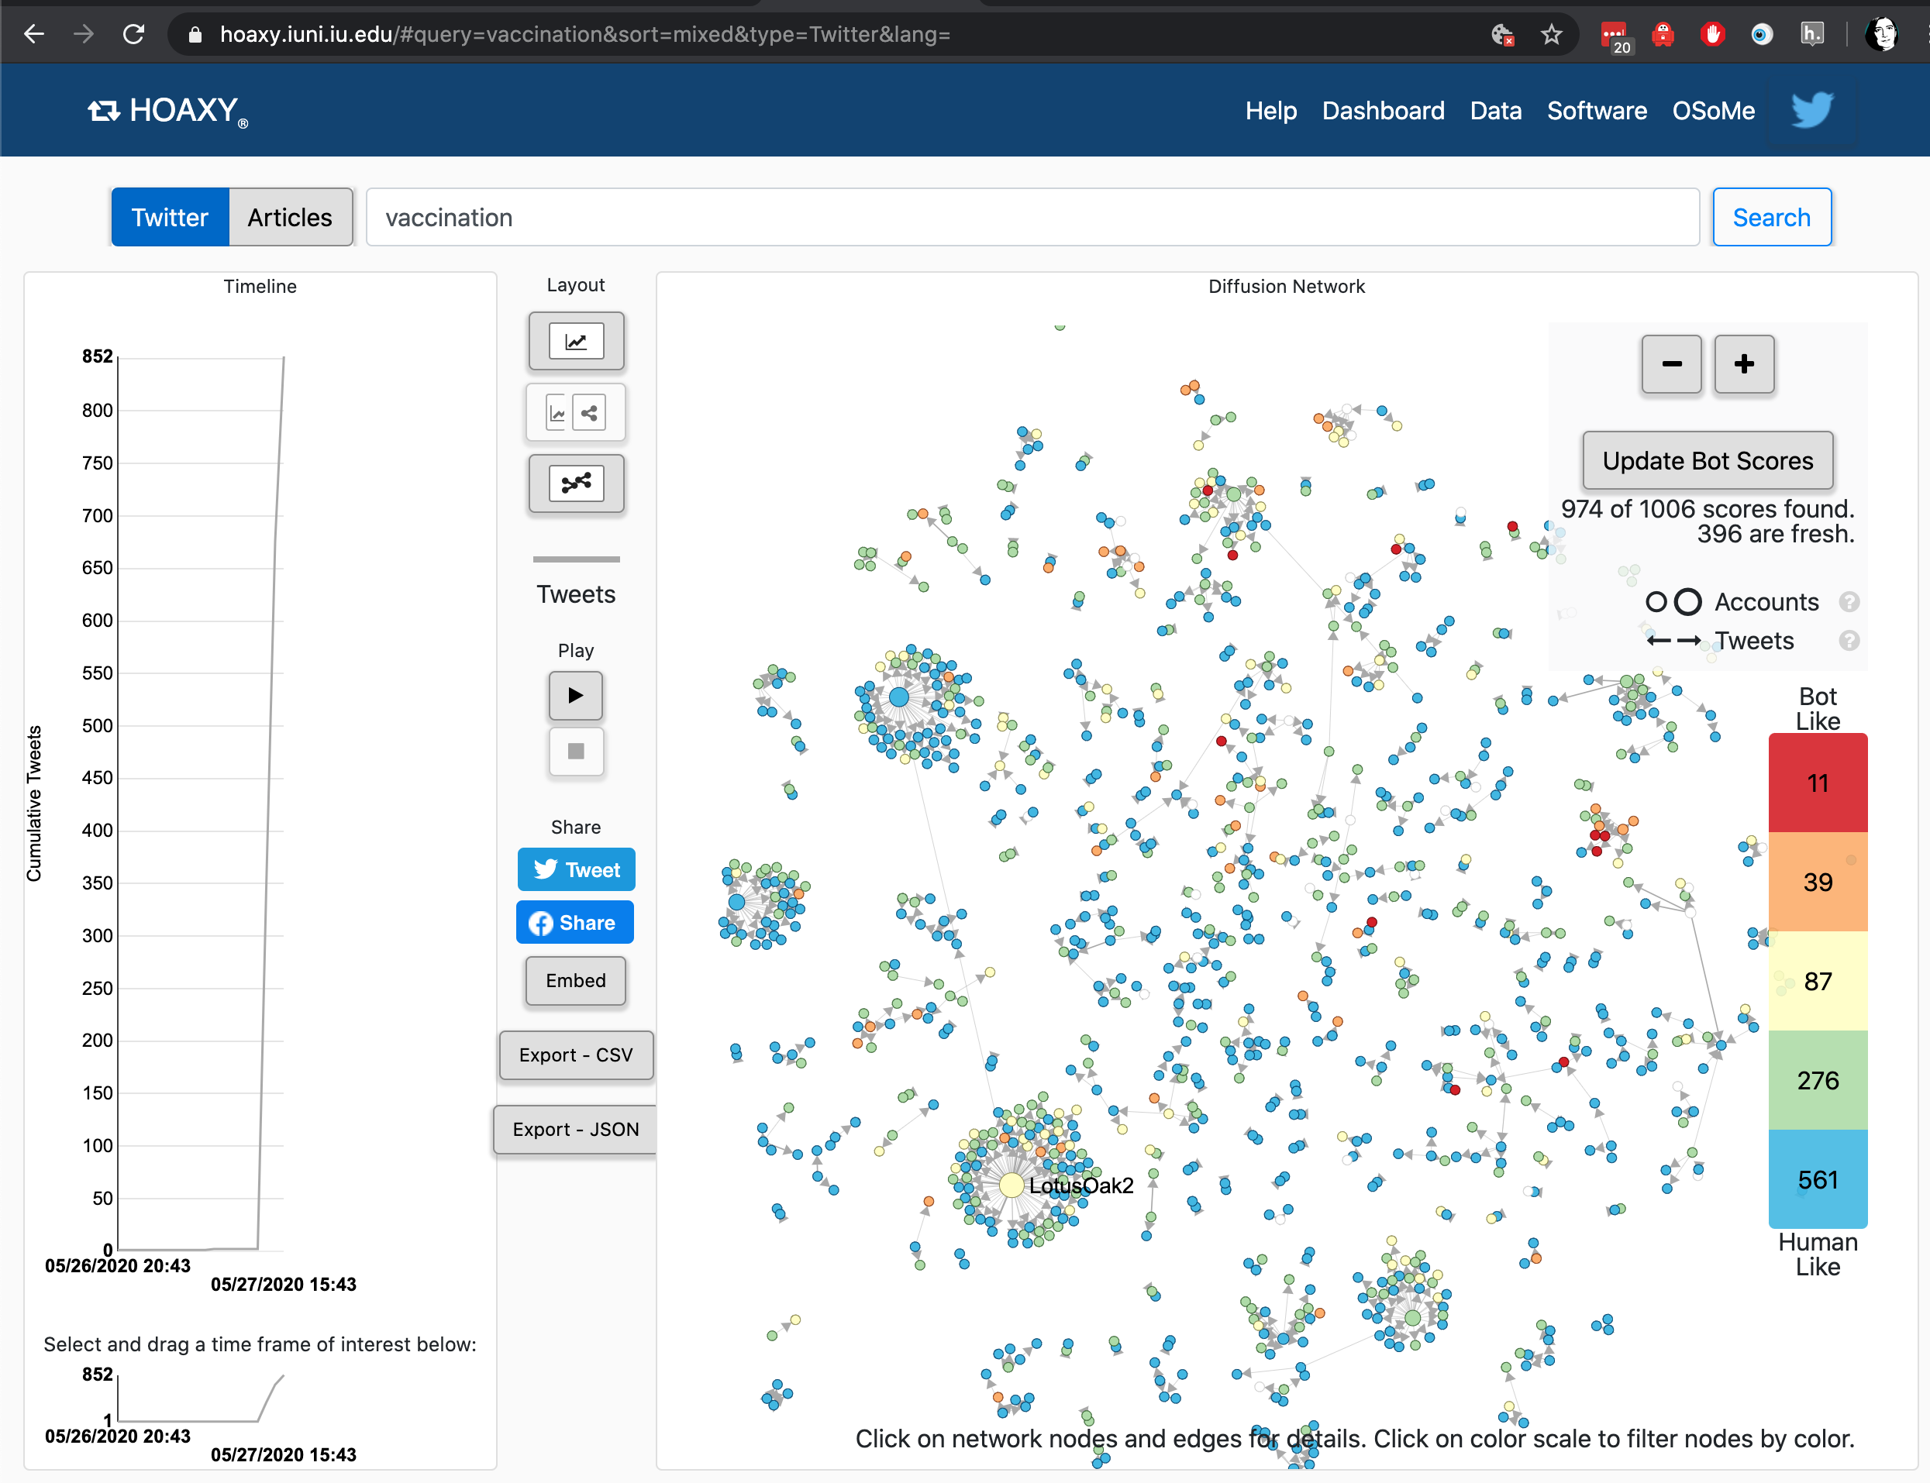
U Indiana data tools
Notes:
https://hoaxy.iuni.iu.edu/#query=vaccination&sort=mixed&type=Twitter&lang=
Hoaxy uses Gephi - we have instructions for how to run twitter through that in the BigBook too.

